Slide 1
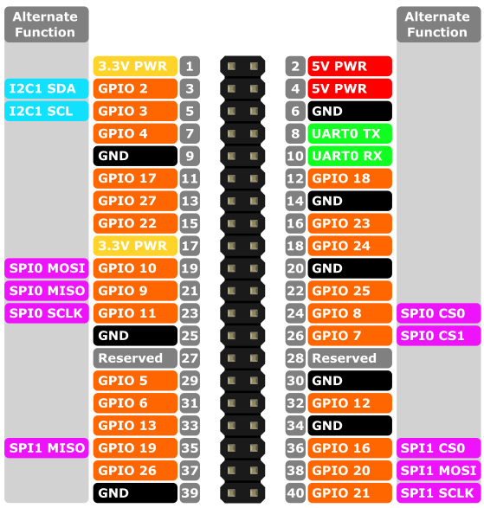
PWR
LCD
I2S
UART
I2C
BackLight
3V3 I2S
5V-IN
5V LCD
PWR BUTTON IN
GND-IN
Arduino-RX
Arduino-TX
Bit-CLK
GND LCD
3V3
SDI
GND I2S
DC
SCK
CS
RESET
L/R-CLK
PWR BUTTON IN
DIN
PWR BUTTON GND
DOUT
|ETHERNET | USB | USB|

